Slide 1


Implementing Decision Trees in R
Notes:
This presentation demonstrates how CART decision tree models can be implemented in R and introduces various ways to interpret the trees.

Slide 2
R Implementation of Decision Trees
We use the ‘rpart’ library from R to implement Decisions Trees (both for classification and regression)
The function rpart() has a parameter called method. If the method is set to ‘anova’ the model will do regression. If the method is set to ‘class’ the model will be a classifier.
There is also an optional control parameter, minsplit with default value of 30, which says how many observation we should have at least at each node before attempting to split it further.
Notes:
R provides various libraries to implement decision trees. Rpart is considered as one of the common and widely used packages to implement decision trees in R. rpart can be used both for classification and regression. In fact, the function rpart has a parameter called method. If the method is set to anova, the model will do the regression. Otherwise, if the method is set to class, classification will be performed. Minisplit is another optional parameter for the method. Minisplit is a parameter that defines the minimum number of observations that should be in a leaf in order for that leaf to be considered for further splitting. The default value for this parameter is 30. In other words, if you have a leaf that has less than 30 observations, the tree would not even consider splitting that node any further.

Slide 3
Stopping Tree Growth
Minsplit: the minimum number of observations that must exist in a node in order for a split to be attempted.
Minbucket: the minimum number of observations in any terminal <leaf> node.
If only one of minbucket or minsplit is specified, the code either sets minsplit to minbucket*3 or minbucket to minsplit/3, as appropriate.
Maxdepth Set the maximum depth of any node of the final tree, with the root node counted as depth 0.
Notes:
In addition to minisplit, there are also two other optional parameters that can be used to control the growth of a tree. The first parameter is the minbucket. The minbucket is the minimum number of observations that we should have in any terminal. So, if only one of the minbuckets or minisplit is specified, the code either sets the minisplit to minbucket multipled by three, or minbucket would be set as minsplit divided by three as appropriate. Another parameter used for the rpart method is maxdepth. Maxdepth, as the name implies, defines the maximum depth of the tree, which is the maximum distance between the root of the tree to any of the terminal nodes. Obviously, if the tree only contains the root node, the depth would be equal to zero.

Slide 4
R Implementation
Additional functions:
where ‘Model’ is the name of the rpart model.
Next, we will try to use decision trees for the earlier problems
print(Model) | print results
summary(Model) | detailed results
plot(Model) | plot decision tree
text(Model) | label the decision tree plot
Notes:
There are also some addition methods that can be used to better interpret rpart models. This includes print, summary plot, and text methods. As the name implies, print will print the result of a model, where model in this case is rpart model. Summary of the model shows the details of the result. Plot will plot the decision tree and text would add labels to the decision tree. We will see these methods used in an example later on.

Slide 5
Predicting Sales of Baby Car Seats
library(ISLR)
## Warning: package 'ISLR' was built under R version 3.4.4
library(rpart) library(rpart.plot)
## Warning: package 'rpart.plot' was built under R version 3.4.4
MyData<-Carseats[,1:8] Model_1=rpart (Sales~.,data=MyData, method=‘anova’)
Notes:
43
Here we want to predict the sales of baby car seats based on a number of variables. The data set is part of the islr package. The first thing is to load the islr library. We also load the rpart libraries and rpart.plot libraries. Subsequently, we select the first eight columns of the car seat data set and store that in a data frame called my data. We then build a model using r part. To do that, we write model_1 equal to rpart, sales against all the variables and then data is my data, method is anova. Remember for the rpart, if the method is set to anova, the CART method will perform regression.

Slide 6
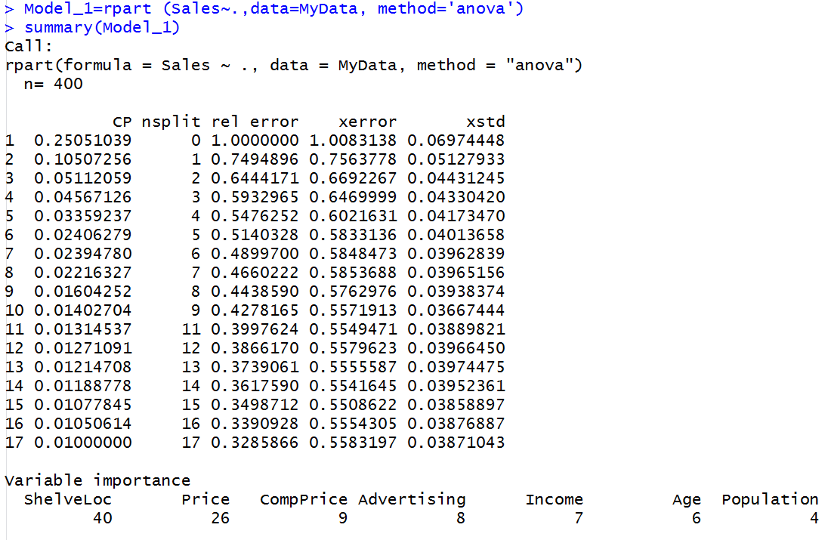
Agenda
Notes:
Here we can see the output of the summary of the model. We can see the different number of splits for a tree, which also corresponds to different complexity parameters. Generally speaking, the higher the complexity parameter or alpha, results in smaller number of splits. So, for example, when CP is set to 0.25, we have zero split, which means we have only the root node. When the CP is decreased to 0.10, then we have one single split. We can also see the relative error and the xerror. So, the rel error or the relative error represents the relative error on the training data set. Whereas the x error is the relative error on thr cross validation data set. So, we can see as we start increasing the number of splits, both the relative error and the xerror start to decrease. This is because we are allowing the tree to grow. However, as we can see, after the 9th split, the relative error starts to decrease, but the xerror or the cross-validation error reaches the error on the validation data set start to increase, which means that from this point on, the model has started to overfit. The standard deviation of the cross-validation error is also shown at the last column. Finally, the decision tree reports the variable importance. In this case we can see the shelf location as being the most important variable with a relative importance of 40 followed by the price, where the relative importance is 26. Age and population are shown to be least important in this model.

Slide 7
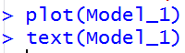
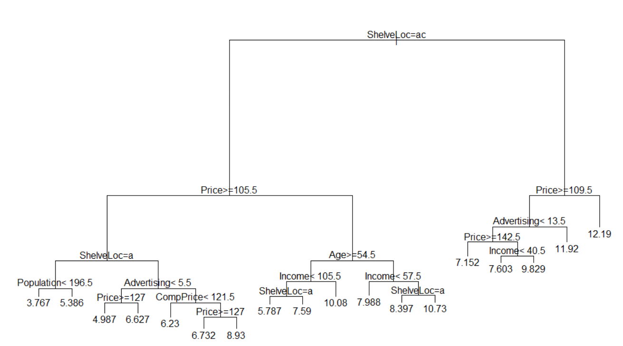
Example
Too Complex!
Notes:
Once the rpart model is constructed, we can use the plot and text command in order to visualize the decision tree. So, the plot basically plots the structure of the tree and text adds labels to the tree. From the tree we can see different splits of different nodes. By default, the left branch is selected if the result of the test is positive. So, as we can see we have so many different splits and so many different branches. This model can be considered as too complex.

Slide 8

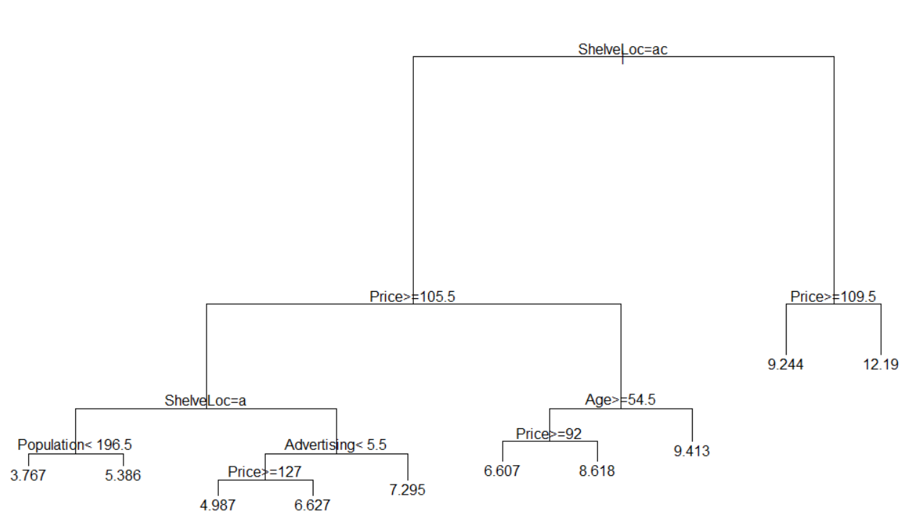
Example
Less Complex!
Notes:
If you recall, an easy way to control the complexity of the model, is to increase the mini split as a control variable. When the minisplit is increased, then the model does not attempt to split the node unless the number of observations in that node exceed the minisplit value. The default value for minisplit is equal to 30. Let’s consider increasing this value to 60. So, in that case we have model_2 rpart, sales against all variables, data is my data, method is anova and then we add the new control variables. We have control is equal to rpart that controls minisplit is equal to 60. The result tree is now plotted here. So, as we can see, the model is much less complex and contains less number of splits. So, on the top we have the shelf location equal to A and C. Recall that shelf location was categorical data, which could take three values. In this case shelf location is equal to A and C. It means that whether shelf location is the first or the third category levels. These category levels are normally listed alphabetically. So, the first level in that case would be bad, the second would be good, and the last one would be medium. So, when shelf location is A and C, it means that whether the shelf location is bad or medium. Then, if we come down on the left-hand side we have the price greater than 100 and 5.5. We can also see the final sales prediction at the leaves. Generally speaking, the more important variables appear at the top of the tree. In this case if you recall, shelf location and price were considered as the two most important variables in the model.

Slide 9
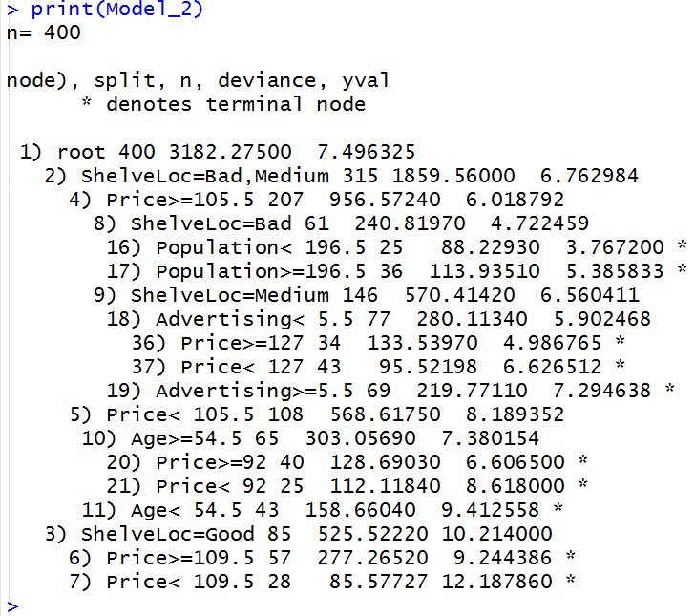
Example
Decision tree Rules! Difficult to follow!
Notes:
We can also use the print function to print the decision tree rules. However, these rules are normally very difficult to read and therefore a better presentation would be the decision tree representation as we have seen before.

Slide 10
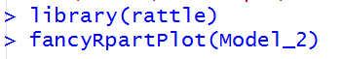
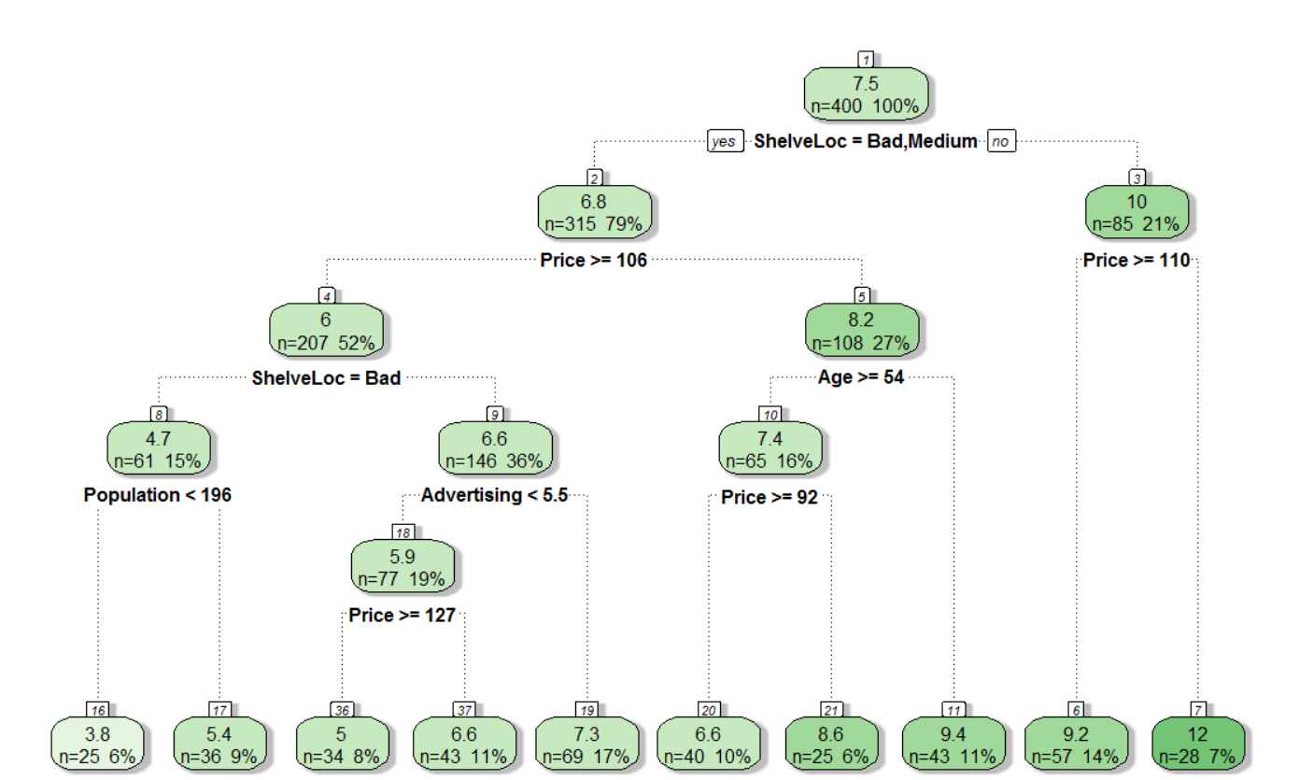
R Example
Much easier to follow!
Notes:
41

